Slide 1


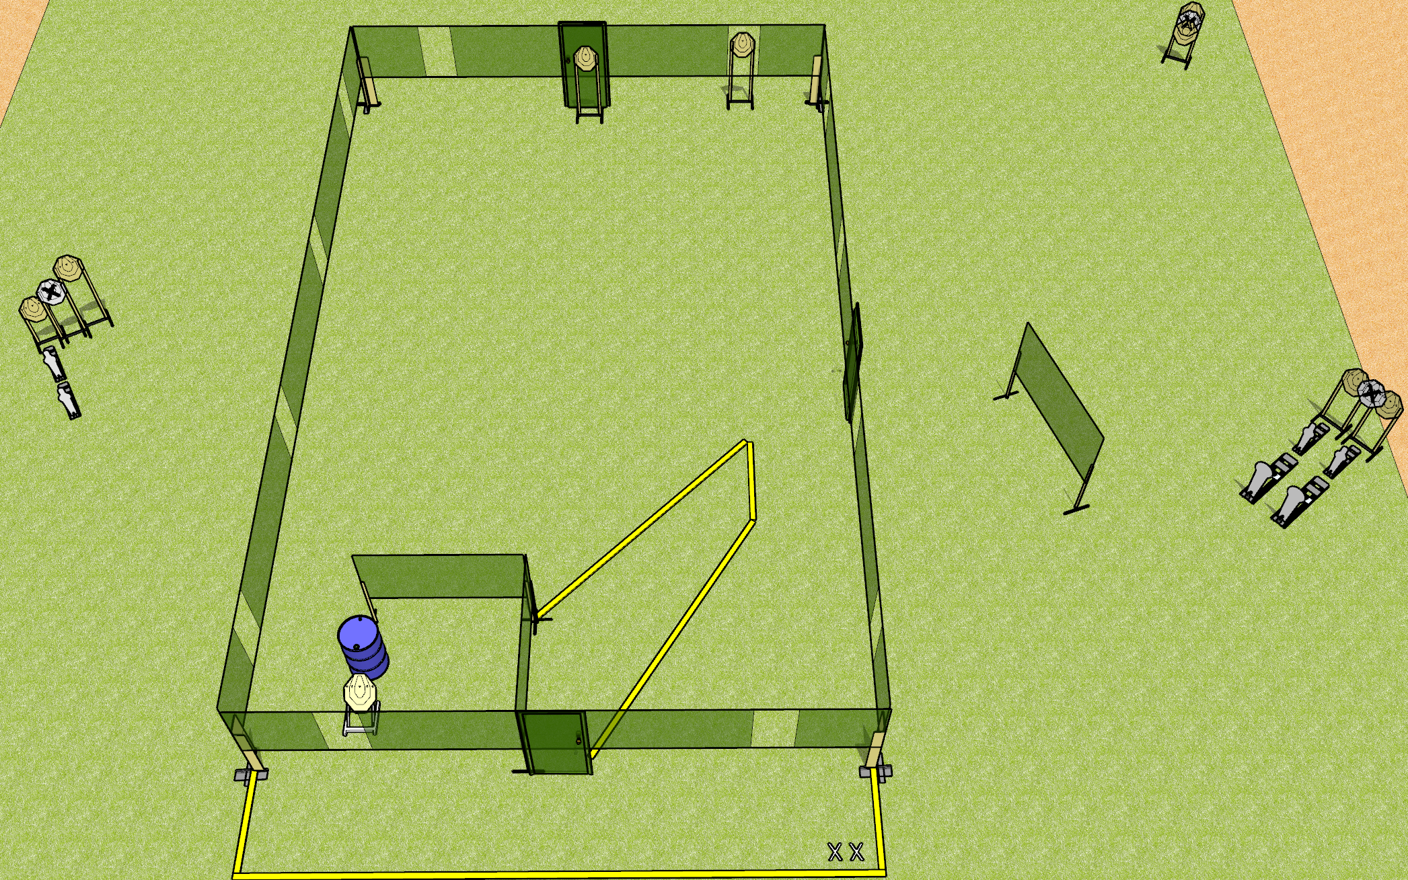
 | Dothan Gun Club – USPSA Match Free Disorientation Course Designer : Patrick Free
Round Count 24 rounds 9 IPSC 2 colt poppers, 4 mini poppers
Equipment List 3 medium fault lines 2 wall feet

Slide 2
Free Disorientation
Written Stage Briefing
Free Disorientation is a 24 round, 120 point, Comstock course of fire. There are 9 IPSC targets, 2 colt poppers, and 4 mini poppers. The best 2 hits on paper will score, and steel must fall to score. The start signal is audible.
Handgun start position is both feet on X’s, wrists above shoulders. Handgun is unloaded and holstered.
PCC start position is both feet on X’s, stock on belt. Unloaded carbine is held with both hands.
On start signal, engage targets as they become available from within the shooting area.

Slide 3
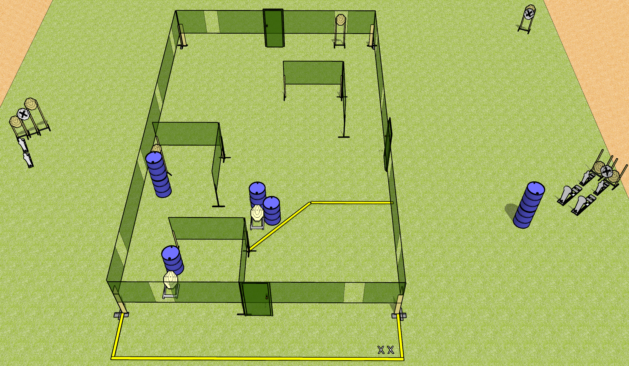
 | Dothan Gun Club – USPSA Match Free Disorientation Course Designer : Patrick Free/Drew Coleman
Round Count 24 rounds 9 IPSC 2 colt poppers, 4 mini poppers
Equipment List 3 medium fault lines

Slide 4
Free Disorientation
Written Stage Briefing
Free Disorientation is a 24 round, 120 point, Comstock course of fire. There are 9 IPSC targets, 2 colt poppers, and 4 mini poppers. The best 2 hits on paper will score, and steel must fall to score. The start signal is audible.
Handgun start position is both feet on X’s, wrists above shoulders. Handgun is holstered with loaded magazine, empty chamber, hammer down.
PCC start position is both feet on X’s, stock on belt. Carbine is held with both hands, magazine inserted, empty chamber, hammer down.
On start signal, engage targets as they become available from within the shooting area.

